Slide 1
CS107 Spring 2019, Lecture 1 Welcome to CS107!
reading:
General Information handout
Bryant & O’Hallaron, Ch. 1

Slide 2
Plan For Today
Introduction
CS107 Course Policies
Unix and the Command Line
Getting Started With C

Slide 3
Plan For Today
Introduction
CS107 Course Policies
Unix and the Command Line
Getting Started With C

Slide 4
What is CS107?
Computer Organization and Systems
How languages like C++ and Java represent data under the hood
How programming structures are encoded in bits and bytes
How to efficiently manipulate and manage memory
How computers compile programs
Uses the C programming language
Programming style and software development practices

Slide 5
CS107 Learning Goals
The goals for CS107 are for students to gain mastery of
- writing C programs with complex use of memory and pointers
- an accurate model of the address space and compile/runtime behavior of C programs
to achieve competence in
- translating C to/from assembly
- writing programs that respect the limitations of computer arithmetic
- identifying bottlenecks and improving runtime performance
- working effectively in a Unix development environment
and have exposure to
- a working understanding of the basics of computer architecture

Slide 6
Course Overview
Bits and Bytes - How can a computer represent integer numbers?
Chars and C-Strings - How can a computer represent and manipulate more complex data like text?
Pointers, Stack and Heap – How can we effectively manage all types of memory in our programs?
Generics - How can we use our knowledge of memory and data representation to write code that works with any data type?
Floats - How can a computer represent floating point numbers in addition to integer numbers?
Assembly - How does a computer interpret and execute C programs?
Heap Allocators - How do core memory-allocation operations like malloc and free work?

Slide 7
You’ll be able to…
Manipulate bits and bytes and work within the limits of computer arithmetic
Implement complex algorithms using C-strings
Re-implement existing Unix tools yourself
Write generic C code that works with a variety of data types
Reverse engineer executable programs without ever seeing the source code
Find security vulnerabilities in programs
Create your own memory allocator to manage heap memory

Slide 8
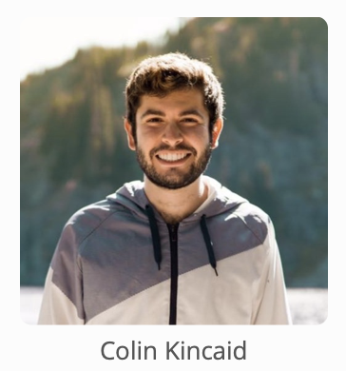
Companion Class: CS107A
CS107A is an extra 1-unit “Pathfinders” or “ACE” section with additional course support, practice and instruction.
Meets for an additional weekly section and has additional review sessions
Entry by application – see the FAQ on the course website for details

Slide 9
Course Website
cs107.stanford.edu
Notes:
Go there for quick tour

Slide 10

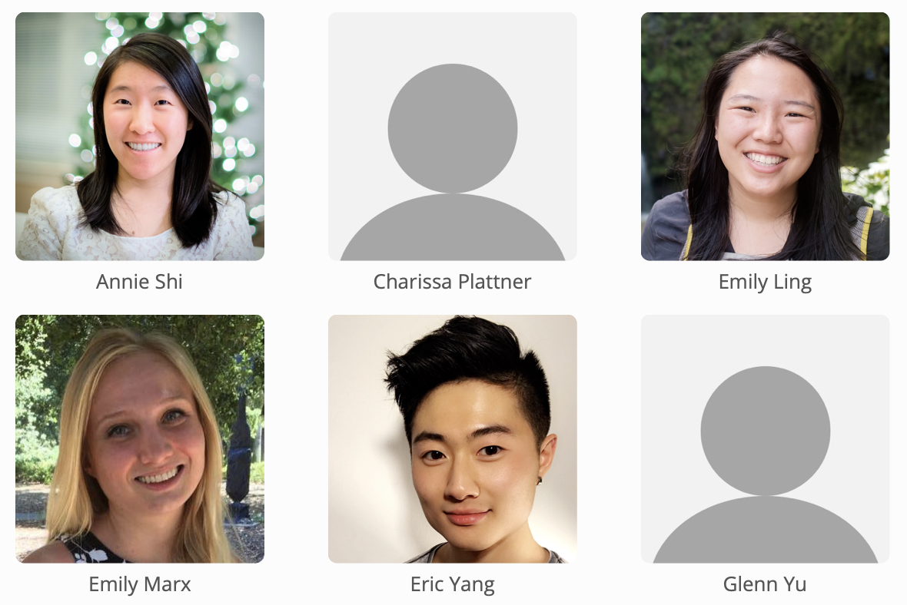
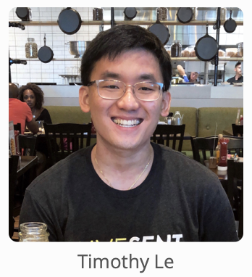

Nice to meet you!
Course Assistants (CAs)
The course staff will lead labs, grade coursework, help you when you have questions, and much more!
Lecturer: Nick Troccoli

Slide 11
Plan For Today
Introduction
CS107 Course Policies
Unix and the Command Line
Getting Started With C

Slide 12
Textbooks
Computer Systems: A Programmer’s Perspective by Bryant & O’Hallaron, 3rd Edition
3rd edition matters – important updates to course materials
A C programming reference of your choice
The C Programming Language by Kernighan and Ritchie (free link on course website Resources page)
Other C programming books, websites, or reference sheets

Slide 13
Grading
**** 35% Assignments
** 15% Lab Participation
** 17% Midterm Exam
**** 33% Final Exam

Slide 14
Grading
**** 35% Assignments
** 15% Lab Participation
** 17% Midterm Exam
**** 33% Final Exam

Slide 15
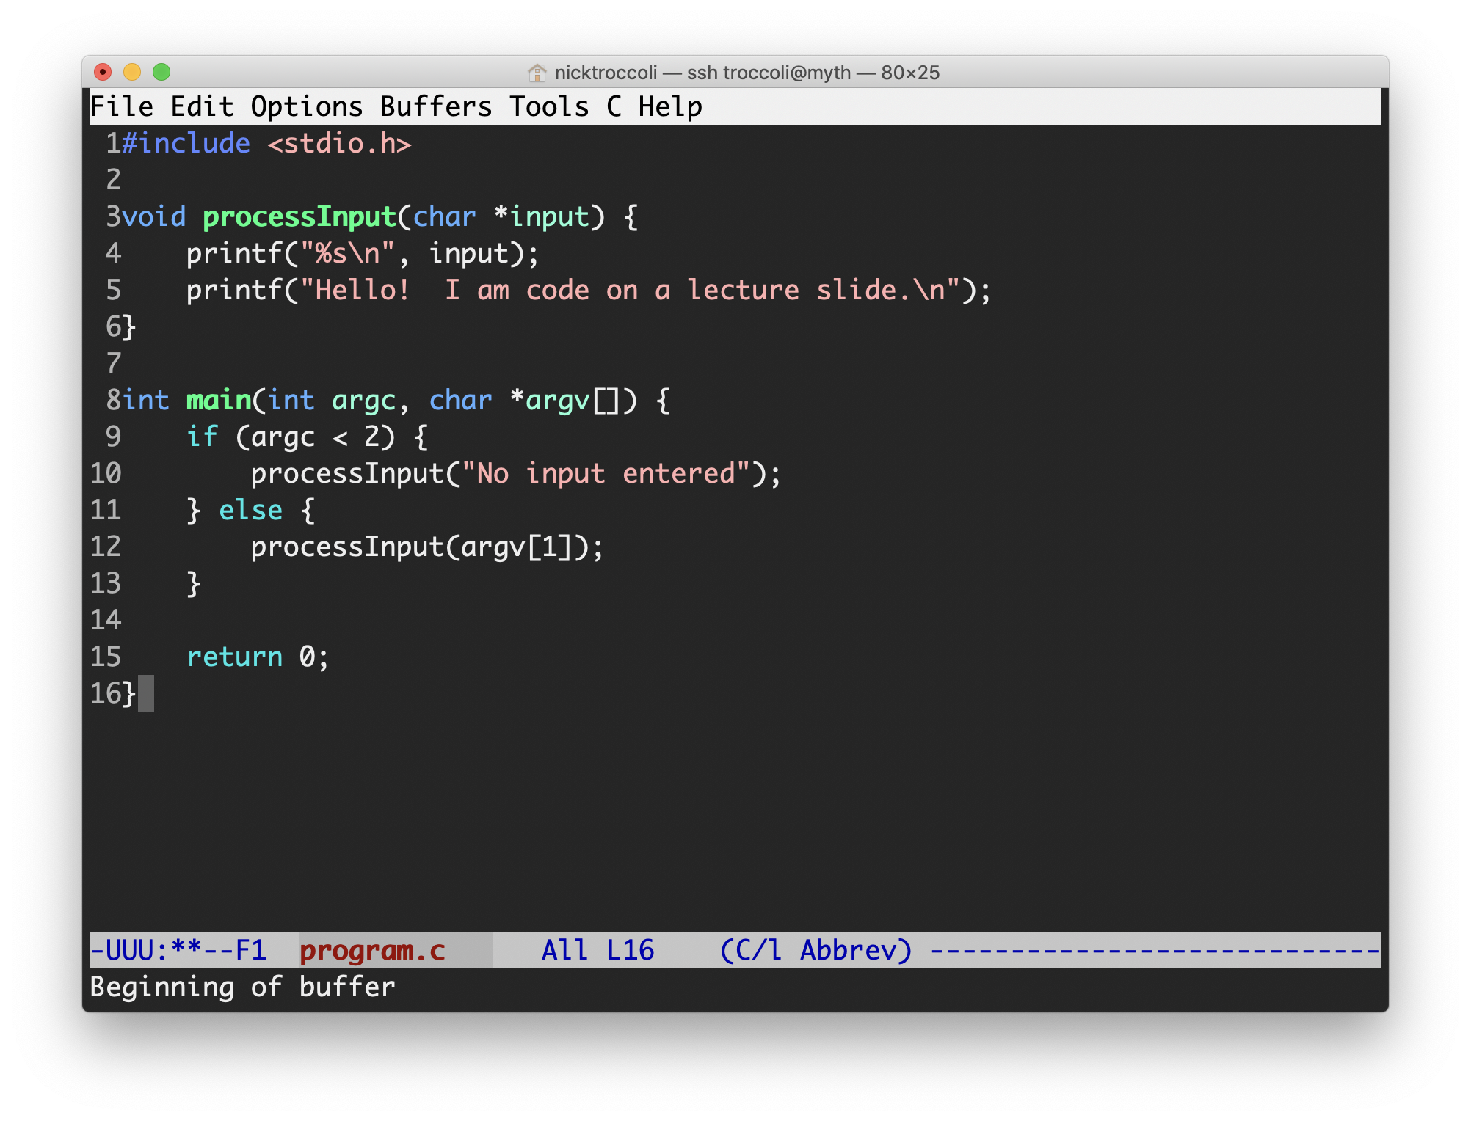
Assignments
8 programming assignments completed individually using Unix command line tools
Free software, pre-installed on Myth machines / available on course website
We will give out starter projects for each assignment
Graded on functionality (behavior) and style (elegance)
Functionality graded using automated tools, given as point score
Style graded via automated tests and TA code review, given as bucket score
Grades returned via course website

Slide 16
The Style Bucket System
+ | An outstanding job; could be used as course example code for good style.
ok | A good job; solid effort, but also opportunities for improvement.
- | Shows some effort and understanding, but has larger problems that should be focused on.
- - | Little effort; incomplete or mostly non-functional.
0 | No work submitted, or barely any changes from the starter assignment.

Slide 17
Getting Help
Post on Piazza
Online discussion forum for students; post questions, answer other students’ questions
Best for course material discussions, course policy questions or general assignment questions (DON’T POST ASSIGNMENT CODE!)
Visit us at office hours
Scheduled throughout the week; schedule will be posted on course website tomorrow
Best for coding/debugging questions, or longer course material discussions
SCPD students can call in to SCPD office hours – more information coming soon
Email the Course Staff
cs107@cs.stanford.edu – please do not email CAs individually
Best for private matters (e.g. grading questions, OAE accommodations).

Slide 18
Late Policy
Submitting by the assignment deadline typically earns an extra-credit on-time bonus, usually ~5%.
If you miss the deadline, there may be a grace period for late submissions, typically 48 hours, but submitting during the grace period does not earn any on-time bonus.
“Pre-granted grace period” – additional extensions granted only in very special circumstances. Instructor must approve extensions.

Slide 19
Grading
**** 35% Assignments
** 15% Lab Participation
** 17% Midterm Exam
**** 33% Final Exam

Slide 20
Lab Sections
Weekly 1 hour 50 minute labs led by a CA, starting next week, offered on Tuesdays, Wednesdays and Thursdays.
Hands-on practice in pairs at computers with lecture material and course concepts.
Graded on attendance + participation (verified by submitting work at the end)
SCPD students complete lab work remotely (more info in SCPD Handout)
Lab signups open Wednesday 4/3 at 5:55PM, and are first-come first-serve. A link will be posted on the course website.

Slide 21
Grading
**** 35% Assignments
** 15% Lab Participation
** 17% Midterm Exam
**** 33% Final Exam

Slide 22
Exams
Midterm exam – Friday, May 10th, 12:30-2:20PM (during full class period)
Final exam – Wednesday, June 12th, 12:15-3:15PM
You MUST be able to take both exams at the scheduled time, except for university athletics or OAE accommodations.
Both exams are closed-book, closed-notes, but you may bring in 1 double-sided page of notes. You will also be provided with a syntax reference sheet.
SCPD students have 24hr window during which to take the exams
Exams are administered electronically via BlueBook

Slide 23
Grading
**** 35% Assignments
** 15% Lab Participation
** 17% Midterm Exam
**** 33% Final Exam

Slide 24
Stanford Honor Code
The Honor Code is an undertaking of the students, individually and collectively:
that they will not give or receive aid in examinations; that they will not give or receive unpermitted aid in class work, in the preparation of reports, or in any other work that is to be used by the instructor as the basis of grading;
that they will do their share and take an active part in seeing to it that others as well as themselves uphold the spirit and letter of the Honor Code.
The faculty on its part manifests its confidence in the honor of its students by refraining from proctoring examinations and from taking unusual and unreasonable precautions to prevent the forms of dishonesty mentioned above. The faculty will also avoid, as far as practicable, academic procedures that create temptations to violate the Honor Code.
While the faculty alone has the right and obligation to set academic requirements, the students and faculty will work together to establish optimal conditions for honorable academic work.
see also: http://honorcode.stanford.edu/
It is your responsibility to ensure you have read and are familiar with the honor code guidelines posted on the main page of the CS107 course website. Please read them, and come talk to us if you have any questions or concerns.

Slide 25
Honor Code and CS107
Please help us ensure academic integrity:
Indicate any assistance received on HW (books, friends, etc.).
Do not look at other people's solution code or answers
Do not give your solutions to others, or post them on the web or our Piazza forum.
Report any inappropriate activity you see performed by others.
Assignments are checked regularly for similarity with help of software tools.
If you realize that you have made a mistake, you may retract your submission to any assignment at any time, no questions asked.
If you need help, please contact us and we will help you.
We do not want you to feel any pressure to violate the Honor Code in order to succeed in this course.

Slide 26
Plan For Today
Introduction
CS107 Course Policies
Unix and the Command Line
Getting Started With C

Slide 27
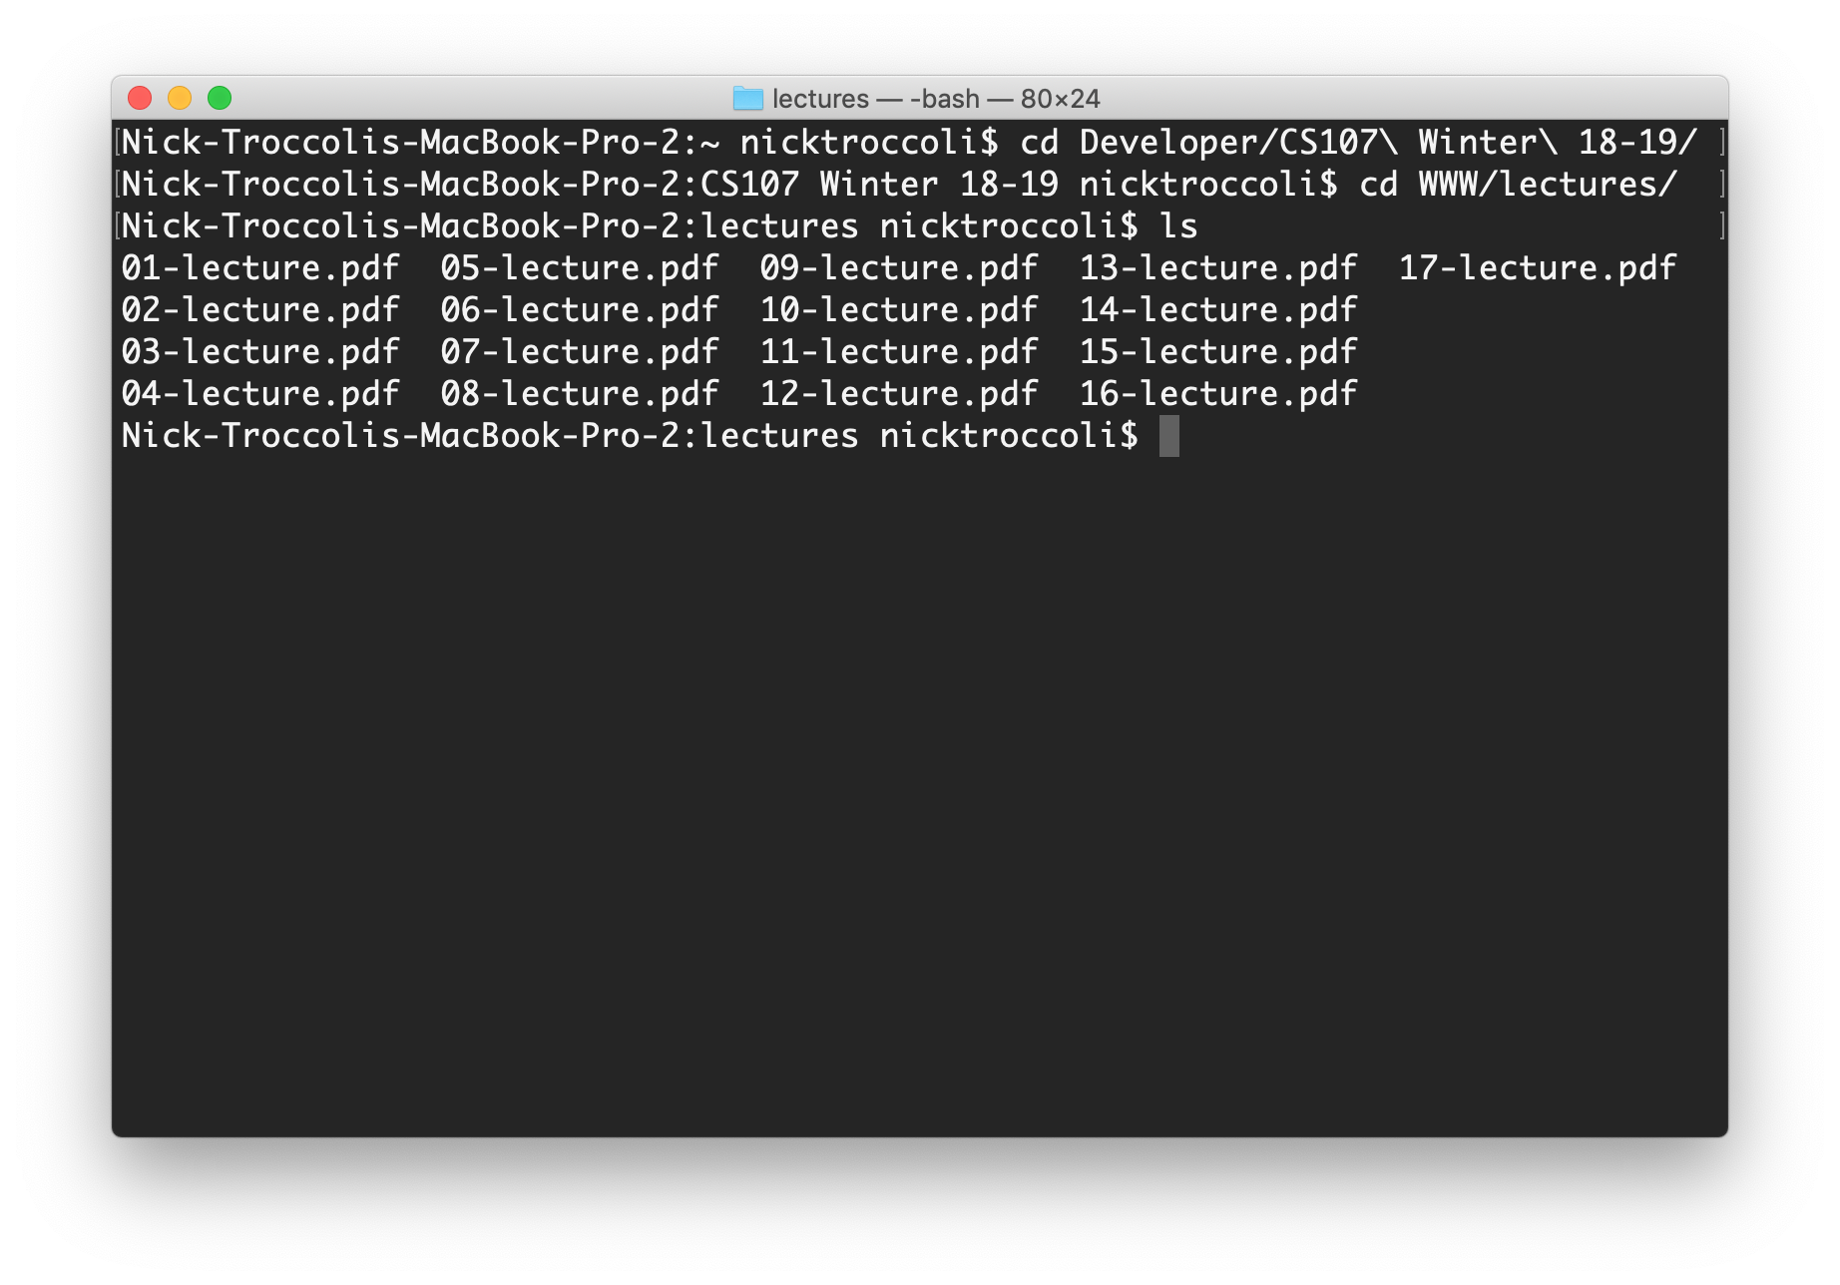
What is Unix?
Unix: a set of standards and tools commonly used in software development.
Macs are built on top of Unix
Linux is built on top of Unix
You can navigate a Unix system using the command line (“terminal”)
Every Unix system works with the same tools and commands

Slide 28
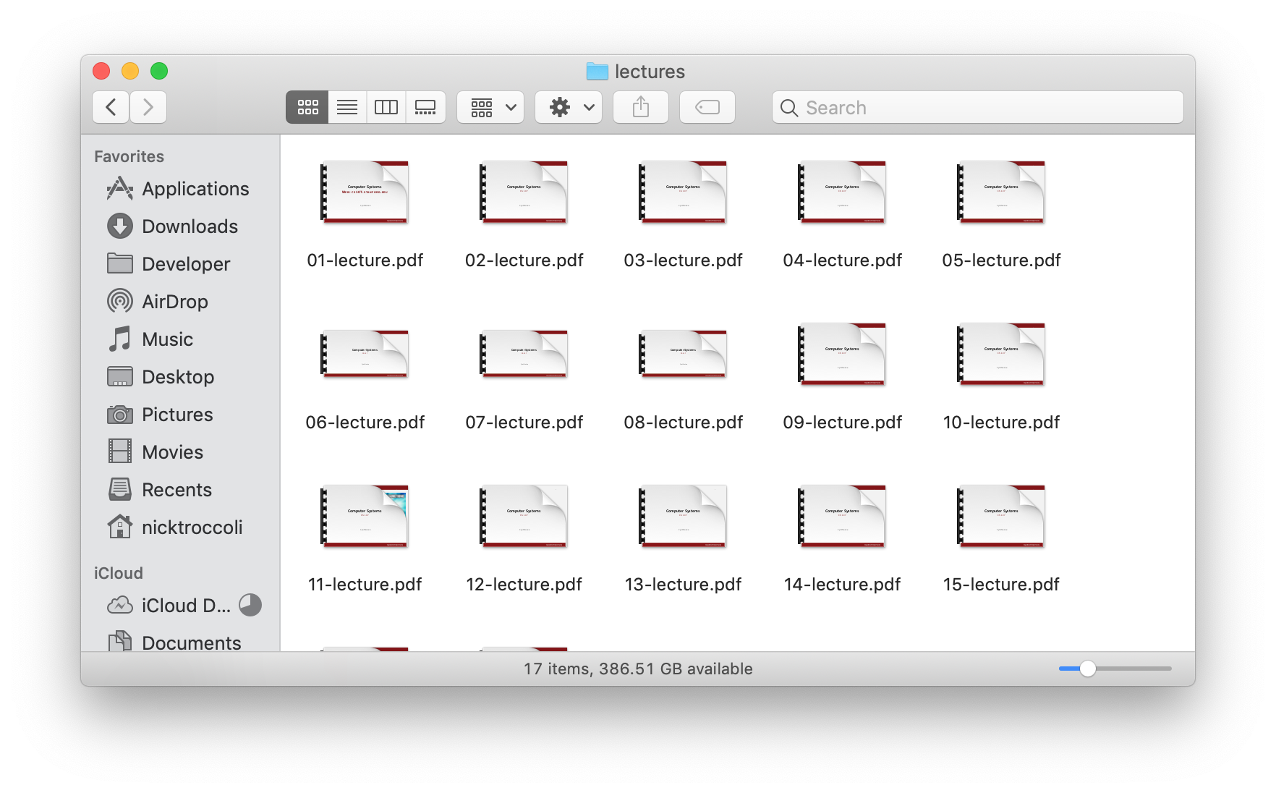
What is the Command Line?
The command-line is a text-based interface to navigate a computer, instead of a Graphical User Interface (GUI).
Graphical User Interface
Text-based interface

Slide 29
Why Use Unix / the Command Line?
You can navigate almost any device using the same tools and commands:
Servers
Laptops and desktops
Embedded devices (Raspberry Pi, etc.)
Mobile Devices (Android, etc.)
Used frequently by software engineers:
Web development: running servers and web tools on servers
Machine learning: processing data on servers, running algorithms
Systems: writing operating systems, networking code and embedded software
Mobile Development: running tools, managing libraries
And more…
We are going to use Unix and the command line to write, debug, and run our programs.
Notes:
Even remotely!

Slide 30
Learning Unix and the Command Line
Using Unix and the command line can be intimidating at first:
It looks really retro!
How do I know what to type?
We are going to teach you how!
Live lecture demos
Lab activities
Assignments
The Resources page of the course website

Slide 31
Command Line Vs. GUI
Just like a GUI file explorer interface, a terminal interface:
shows you a specific place on your computer at any given time.
lets you go into folders and out of folders.
lets you create new files and edit files.
lets you run programs.
Graphical User Interface
Command-line interface

Slide 32
Demo: Using Unix and the Command Line

Slide 33
Unix Commands Recap
cd – change directories
ls – list directory contents
mkdir – make directory
emacs – open text editor
rm – remove file or folder
man – view manual pages
See the Resources page of the course website for more commands, and a complete reference.

Slide 34
Plan For Today
Introduction
CS107 Course Policies
Unix and the Command Line
Getting Started With C

Slide 35
The C Language
C was created around 1970 to make writing Unix and Unix tools easier.
Part of the C/C++/Java family of languages (C++ and Java were created later)
Design principles:
Small, simple abstractions of hardware
Minimalist aesthetic
Prioritizes efficiency and minimalism over safety and high-level abstractions

Slide 36
C vs. C++ and Java
They all share:
Syntax
Basic data types
Arithmetic, relational, and logical operators
C doesn’t have:
More advanced features like operator overloading, default arguments, pass by reference, classes and objects, ADTs, etc.
Extensive libraries (no graphics, networking, etc.) – this means not much to learn C!
many compiler and runtime checks (this may cause security vulnerabilities!)

Slide 37
Programming Language Philosophies
C is procedural: you write functions, rather than define new variable types with classes and call methods on objects. C is small, fast and efficient.
C++ is procedural, with objects: you write functions, and also define new variable types with classes, and call methods on objects.
Java is object-oriented: it is even more centered around defining new variable types with classes, and calling methods on objects.
Notes:
C++ is C+1!

Slide 38
Why C?
Many tools (and even other languages, like Python!) are built with C.
C is the language of choice for fast, highly efficient programs.
C is popular for systems programming (operating systems, networking, etc.)
C lets you work at a lower level to manipulate and understand the underlying system.

Slide 39
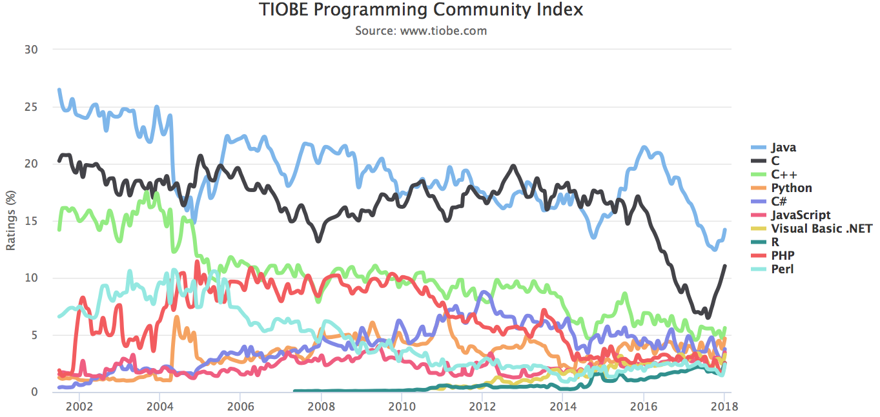
Programming Language Popularity

Slide 40
Our First C Program
/*
* hello.c
* This program prints a welcome message
* to the user.
*/
#include <stdio.h> // for printf
int main(int argc, char *argv[]) {
printf("Hello, world!\n");
return 0;
}

Slide 41
Our First C Program
/*
* hello.c
* This program prints a welcome message
* to the user.
*/
#include <stdio.h> // for printf
int main(int argc, char *argv[]) {
printf("Hello, world!\n");
return 0;
}
Program comments
You can write block or inline comments.

Slide 42
Our First C Program
/*
* hello.c
* This program prints a welcome message
* to the user.
*/
#include <stdio.h> // for printf
int main(int argc, char *argv[]) {
printf("Hello, world!\n");
return 0;
}
Import statements
C libraries are written with angle brackets.
Local libraries have quotes:
#include "lib.h"

Slide 43
Our First C Program
/*
* hello.c
* This program prints a welcome message
* to the user.
*/
#include <stdio.h> // for printf
int main(int argc, char *argv[]) {
printf("Hello, world!\n");
return 0;
}
Main function – entry point for the program
Should always return an integer (0 = success)

Slide 44
Our First C Program
/*
* hello.c
* This program prints a welcome message
* to the user.
*/
#include <stdio.h> // for printf
int main(int argc, char *argv[]) {
printf("Hello, world!\n");
return 0;
}
Main parameters – main takes two parameters, both relating to the command line arguments used to execute the program.
argc is the number of arguments in argv
argv is an array of arguments (char * is C string)

Slide 45
Our First C Program
/*
* hello.c
* This program prints a welcome message
* to the user.
*/
#include <stdio.h> // for printf
int main(int argc, char *argv[]) {
printf("Hello, world!\n");
return 0;
}
printf – prints output to the screen
Notes:
\n

Slide 46
Familiar Syntax
int x = 42 + 7 * -5; // variables, types
double pi = 3.14159;
char c = 'Q'; /* two comment styles */
for (int i = 0; i < 10; i++) { // for loops
if (i % 2 == 0) { // if statements
x += i;
}
}
while (x > 0 && c == 'Q' || b) { // while loops, logic
x = x / 2;
if (x == 42) { return 0; }
}
fooBar(x, 17, c); // function call

Slide 47
Boolean Variables
To make Boolean variables, (e.g. bool b = ____), you must import stdbool.h:
#include <stdio.h> // for printf
#include <stdbool.h> // for bool
int main(int argc, char *argv[]) {
bool x = 5 > 2;
if (x) {
printf("Hello, world!\n");
} else {
printf("Howdy, world!\n");
}
return 0;
}

Slide 48
Boolean Expressions
C treats a nonzero value as true, and a zero value as false:
#include <stdio.h>
int main(int argc, char *argv[]) {
int x = 5;
if (x) { // true
printf("Hello, world!\n");
} else {
printf("Howdy, world!\n");
}
return 0;
}

Slide 49
Console Output: printf
printf(text, arg1, arg2, arg3);
// Example
char *classPrefix = "CS";
int classNumber = 107;
printf("You are in %s%d", classPrefix, classNumber); // You are in CS107
printf makes it easy to print out the values of variables or expressions.
If you include placeholders in your printed text, printf will replace each placeholder in order with the values of the parameters passed after the text.
%s (string) %d (integer) %f (double)

Slide 50
Writing, Debugging and Compiling
We will use:
the emacs text editor to write our C programs.
the gcc and make tools to compile our C programs.
the gdb debugger to debug our programs.
the valgrind tools to debug memory errors, and measure the efficiency of our programs.

Slide 51
Text Editor
Emacs is the editor we recommend and will use this quarter in lectures and labs to write and edit C programs.
There are helpful emacs tips and guides on the Resources page of the course website.
We will only support the emacs text editor this quarter for working on programs. In particular, we do not recommend using a local text editor such as Sublime Text due to risks of data loss.

Slide 52
Demo: Compiling And Running A C Program

Slide 53
Working On C Programs Recap
ssh – remotely log in to Myth computers
Emacs – text editor to write and edit C programs
Use the mouse to position cursor, scroll, and highlight text
Ctl-x Ctl-s to save, Ctl-x Ctl-c to quit
make – compile program using provided Makefile
./myprogram – run executable program (optionally with arguments)
make clean – remove executables and other compiler files
Lecture code is accessible at /afs/ir/class/cs107/samples/lect[N]
Hint: try looking up the cp command for how to make your own copy to edit/run!
See the Resources page of the course website for more commands, and a complete reference.

Slide 54
assign0
Assignment 0 (Introduction to Unix and C) is released on the course website, and is due in one week on Mon. 4/8 at 11:59PM PST.
There are 5 parts to the assignment, which is meant to get you comfortable using the command line, and editing/compiling/running C programs:
Visit the Resources page to become familiar with different Unix commands
Clone the assign0 starter project
Answer several questions in readme.txt
Compile a provided C program and modify it
Submit the assignment

Slide 55
Recap
CS107 is a programming class in C that teaches you about what goes on under the hood of programming languages and software.
We’ll use Unix and command line tools to write, debug and run our programs.
Please visit the course website, cs107.stanford.edu, where you can read the General Information Handout, information about the Honor Code in CS107, and more about CS107 course policies and logistics.
We’re looking forward to an awesome quarter!
Next time: How can a computer represent integer numbers?

